Slide 1
Real World Interactive Learning
Alekh Agarwal
John Langford
KDD Tutorial, August 19
Slides and full references at http://hunch.net/~rwil/kdd2018.html

Slide 2
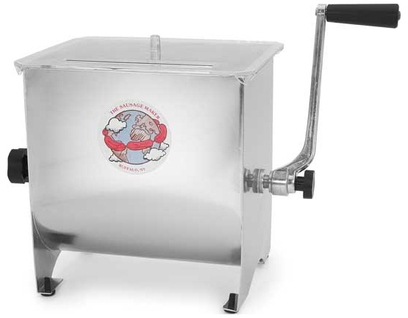
The Supervised Learning Paradigm
1 | 1 | 5 | 4 | 3
7 | 5 | 3 | 5 | 3
5 | 5 | 9 | 0 | 6
3 | 5 | 2 | 0 | 0
Accurate digit classifier
Training examples
Training labels
Supervised Learner
2
Notes:
ML takes a different approach. By applying concepts from a range of fields, including statistics, probability theory, and so on, we can build an ML system that “learns” to recognize handwritten digits by being trained on thousands, or even millions, of examples.
So, in order to get an accurate digit classifier, all we need to do is acquire lots of training examples, with labels (this is called “labeled training data”), and then feed it into the ML system.

Slide 3
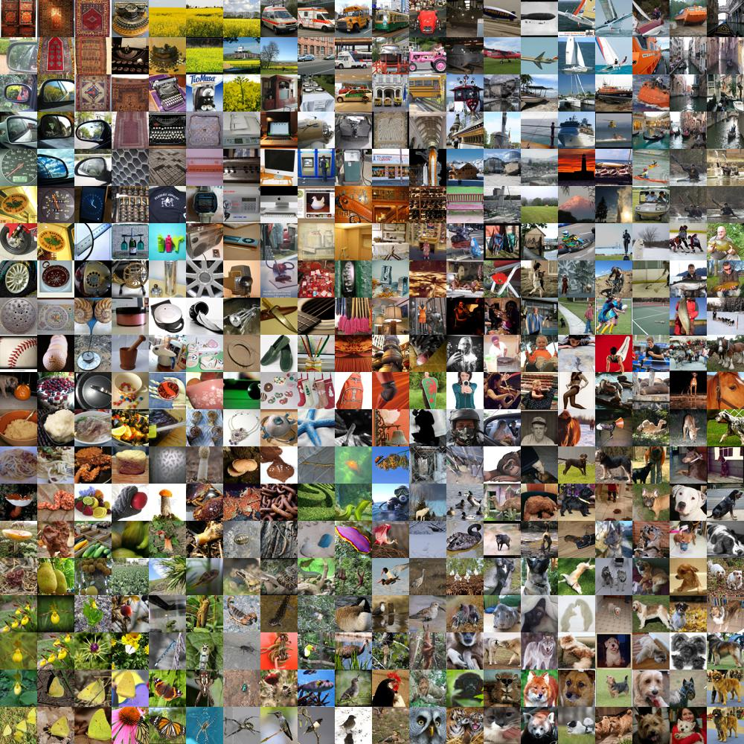
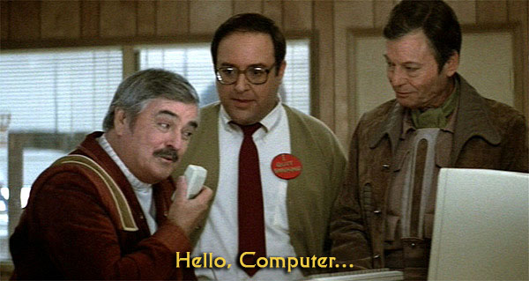
Supervised Learning is cool

Slide 4
How about news?
Repeatedly:
Observe features of user+articles
Choose a news article.
Observe click-or-not
Goal: Maximize fraction of clicks
Notes:
Add Wellness

Slide 5
A standard pipeline
Collect $(user, article, click)$ information.
Build $features(user,article)$
Learn $\hat{P}\left(click\right|features(user,article))$
Act: $arg\max_{\left\{articles\right\}} \hat{P}(click|features(user,article))$
Deploy in A/B test for 2 weeks
A/B test fails ☹ Why?

Slide 6
Q: What goes wrong?
Is childproofing interesting to Alekh?
A: Need Right Signal for Right Answer

Slide 7
Q: What goes wrong?
Model value over time
A: The world changes!

Slide 8
Interactive Learning
Action
(selected news story)
Learning
Features
(user history, news stories)
Consequence
(click-or-not)

Slide 9
Q: Why Interactive Learning?
A: $$$
Use free interaction data
rather than expensive labels

Slide 10
Q: Why Interactive Learning?
AI: A function programmed with data
AI: A function programmed with data
AI: An economically viable digital agent that explores, learns, and acts

Slide 11
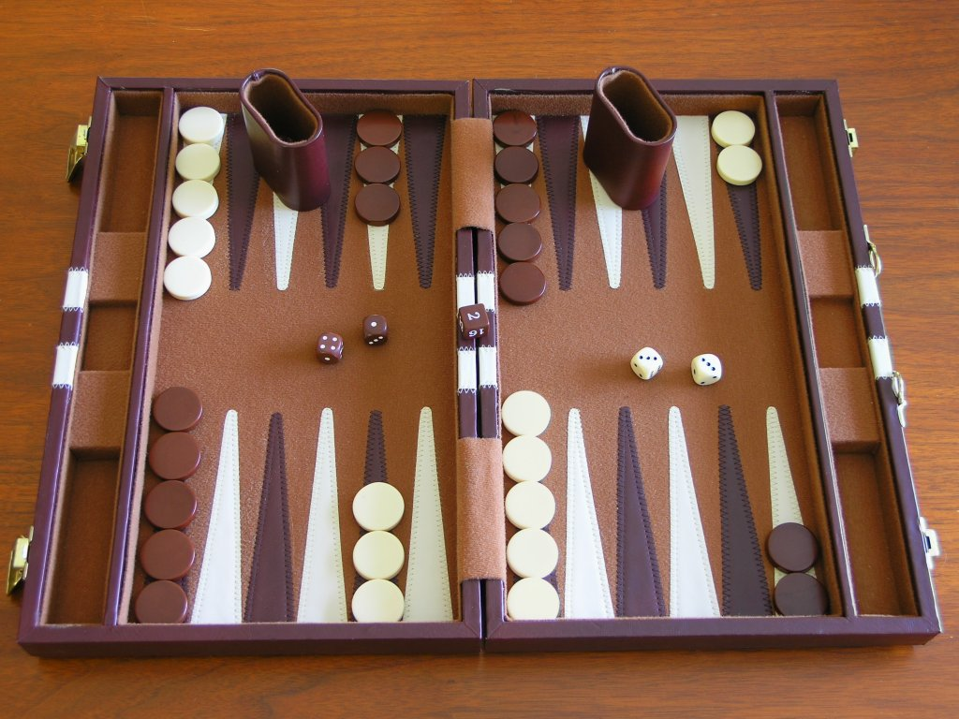
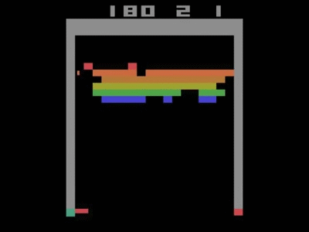
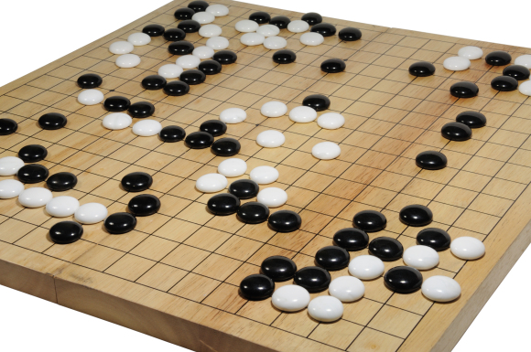
Flavors of Interactive Learning
Full Reinforcement Learning:
Special
Domains
+Right Signal, -Nonstationary Bad, -$$$ +AI
Contextual Bandits: Immediate Reward RL
$±$Rightish Signal, +Nonstationary ok, +$$$, +AI
Active Learning: Choose examples to label.
-Wrong Signal, -Nonstationary bad, +$$$, -”not AI”
Notes:
Revisit after motivations

Slide 12
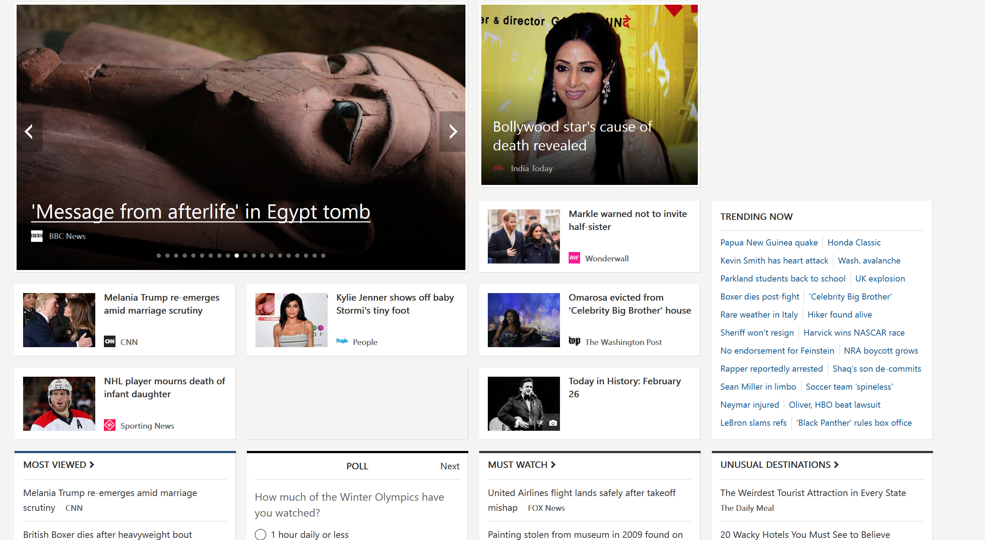
What is RL?
Repeatedly
Observe user profile
Recommend news story
Observe user’s response
Goal: Maximize a user engagement metric
e.g.: clicks, dwell time, number of visits
Context/state
Action/decision
Reward
Long-term reward

Slide 13
Contextual bandits (CBs)
Repeatedly
Observe user profile
Recommend news story
Observe user’s response
Goal: Maximize a user engagement metric
e.g.: clicks, dwell time, number of visits
Context/state
Action/decision
Reward
Long-term reward

Slide 14
Contextual bandits (CBs)
Repeatedly
Observe user profile
Recommend news story
Observe user’s response
Goal: Maximize a user engagement metric
e.g.: clicks, dwell time
Contextual bandit assumption:
Choice of actions at one time-step does not effect future contexts and rewards.
e.g.: Recommendations to one user do not influence another’s preferences
Ignoring long-term effects on the same user
Many works: $(x,\vec{r})$ are drawn i.i.d. from the same distribution at each round.
Context/state
Action/decision
Reward
Immediate reward

Slide 15
Ex: Which advice?
Repeatedly:
Observe features of user+advice
Choose an advice.
Observe steps walked
Goal: Healthy behaviors

Slide 16
Other Real-world Applications
News Rec: [LCLS ‘10]
Ad Choice: [BPQCCPRSS ‘12]
Ad Format: [TRSA ‘13]
Education: [MLLBP ‘14]
Music Rec: [WWHW ‘14]
Robotics: [PG ‘16]
Wellness/Health: [ZKZ ’09, SLLSPM ’11, NSTWCSM ’14, PGCRRH ’14, NHS ’15, KHSBATM ‘15, HFKMTY ’16]

Slide 17
Why CBs?
Reasonable approximation for many applications
News, ads, education, music recommendation, robotics, health/wellness …
Eliminates need for long-term planning
Still need to explore across actions
while generalizing across contexts
and obtaining high rewards
Application integration remains challenging

Slide 18
Take-aways
Good fit for many real problems

Slide 19
Outline
Algs & Theory Overview
Evaluate?
Learn?
Explore?
Things that go wrong in practice
Systems for going right
Really doing it in practice

Slide 20
Contextual Bandits
Repeatedly:
Observe features $x$
Choose action $a∈A$ based on features
Observe reward $r$
Goal: Maximize expected reward

Slide 21
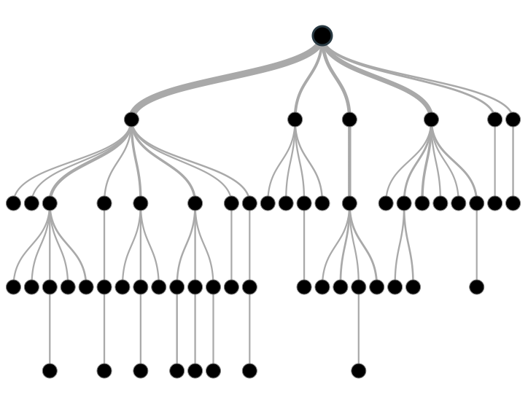
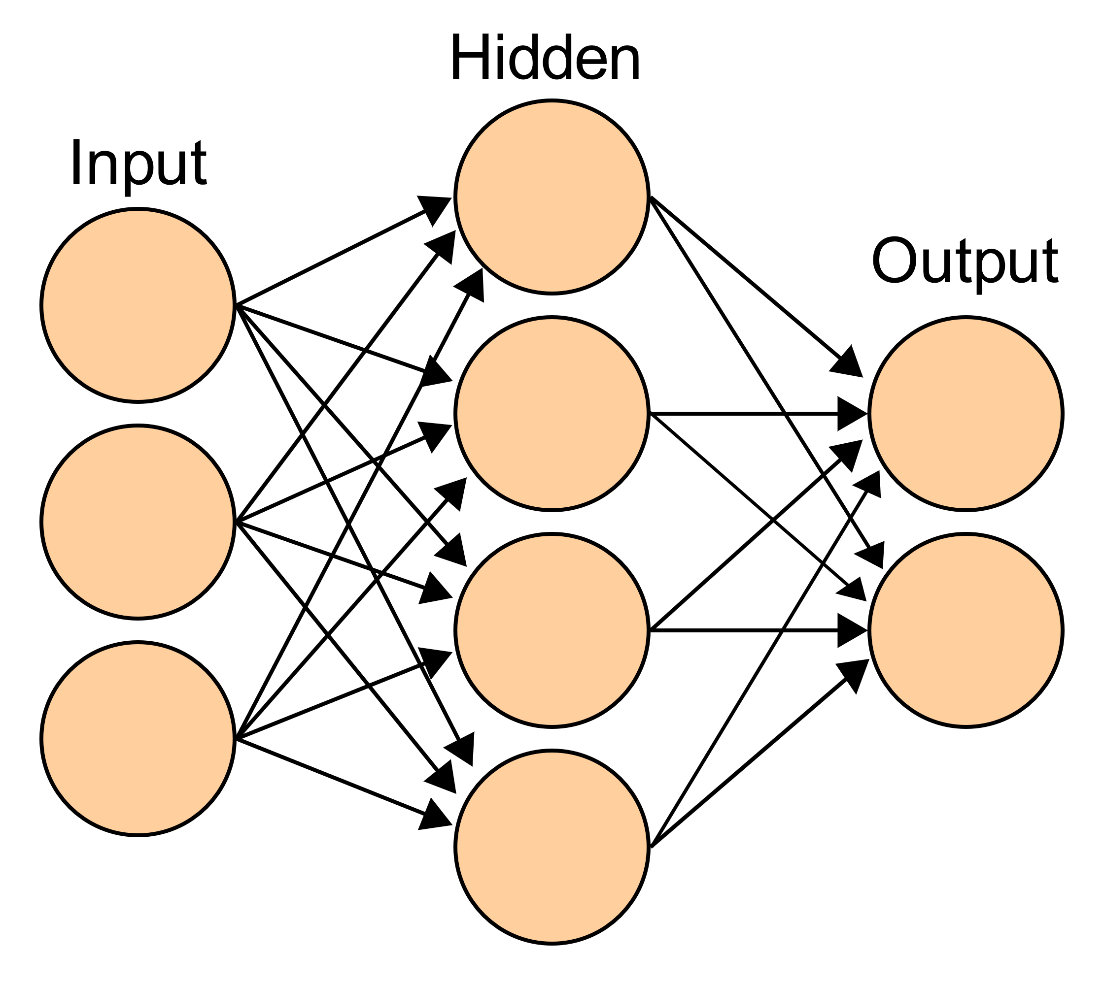
Policies
Policy maps features to actions.
Policy = Classifier that acts.

Slide 22
Exploration
Policy

Slide 23
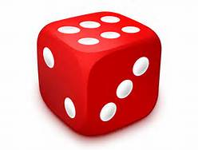
Exploration
Randomization
Policy

Slide 24
Exploration
Randomization
Policy

Slide 25
Inverse Propensity Score(IPS) [HT ‘52]
Given experience ${\left.\left\{\left(x,a,p,r\right)\right.\right\}}^{ }$and a policy $π:x→a$, how good is $π$?
$$V_{\text{IPS}}\left(π\right)=\frac{1}{n}\sum_{(x,a,p,r)}{\frac{rI(π\left(x\right)=a)}{p}}$$
Matches
Propensity Score

Slide 26
What do we know about IPS?
Theorem: For all $π$, for all $D(x,\vec{r})$
$\left.\text{E}\left[r_{π\left(x\right)}\right.\right]=\text{E}\left.\left[V_{\text{IPS}}\left(π\right)\right.\right]\text{ = }\text{E}\left[\frac{1}{n}\sum_{\left(x,a,p,r\right)}{\frac{rI\left(π\left(x\right)=a\right)}{p}}\right]$
Proof: For all $(x,\vec{r})$, $E_{a∼\vec{p}}\left[\frac{r_{a}I(π\left(x\right)=a)}{p_{a}}\right]$
$=\sum_{a}{p_{a}\frac{r_{a}I(π\left(x\right)=a)}{p_{a}}}$
$=r_{π(x)}$

Slide 27
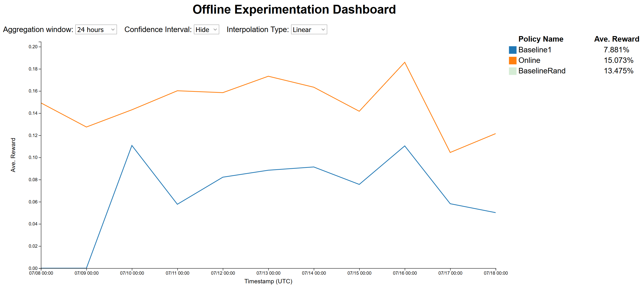
Reward over time
System’s actual online performance
Offline estimate of a baseline’s
performance
Notes:
Add reference slide for evaluation

Slide 28
Better Evaluation Techniques
Double Robust: [DLL ‘11]
Weighted IPS: [K ’92, SJ ‘15]
Clipping: [BL ’08]

Slide 29
Learning from Exploration [‘Z 03]
Given Data $\left\{\left(x, a, p,r\right)\right\}$ how to maximize $\text{E}[r_{π\left(x\right)}]$?
Maximize $\text{E}\left[V_{\text{IPS}}\left(π\right)\right]$ instead!
$$r_{a}= \left\{\begin{aligned}r/p \text{if} π\left(x\right)=a \\ 0 \text{otherwise} \end{aligned}\right.$$
Equivalent to:
$$r_{a}^{′}= \left\{\begin{aligned}1 \text{if} π\left(x\right)=a \\ 0 \text{otherwise} \end{aligned}\right.$$
with importance weight $\frac{r}{p}$
Importance weighted multiclass classification!

Slide 30
Vowpal Wabbit: Online/Fast learning
BSD License, 10 year project
Mailing List>500, Github>1K forks, >4K stars, >1K issues, >100 contributors
Command Line/C++/C#/Python/Java/AzureML/Daemon

Slide 31
VW for Contextual Bandit Learning
echo “1:2:0.5 | here are some features” | vw --cb 2
Format: <action>:<loss>:<probability> | features…
Implements several algorithms for policy learning from exploration data

Slide 32
Better Learning from Exploration Data
Policy Gradient: [W ‘92]
Offset Tree: [BL ’09]
Double Robust for learning: [DLL ‘11]
Importance Weighted Regression: [BAL ‘18]
Weighted IPS for learning: [SJ ‘15]

Slide 33
Evaluating Online Learning
Problem: How do you evaluate an online learning algorithm Offline?
Answer: Use Progressive Validation [BKL ’99, CCG ‘04]
Theorem:
1) Expected PV value = Uniform expected policy value.
2) Trust like a test set error.

Slide 34
How do you do Exploration?
Simplest Algorithm: $ε$-greedy.
With probability $ε$ act uniformly at random
With probability $1−ε$ act greedily using best policy on all seen data so far

Slide 35
Better Exploration Algorithms
Ensemble-based UCB-based
Thompson Sampling: [T ‘33] LinUCB: [CLRS ‘11, A’02]
EXP4: [ACFS ‘02] RegCB: [FADLS ‘18]
Epoch Greedy: [LZ ‘07]
Polytime: [DHKKLRZ ‘11]
Cover&Bag: [AHKLLS ‘14]
Bootstrap: [EK ‘14]

Slide 36
Ensemble-based exploration
Maintain distribution over policies good so far
On a new context, sample a policy and take its action
Avoid choosing obviously bad actions*
Diverse policies to cover all plausibly good actions
Refine distribution as we see more data – explore/exploit tradeoff
Algorithms robust with minimal assumptions
*Typically rely on some uniform exploration

Slide 37
UCB-based exploration
Maintain confidence intervals for reward of actions given context

Slide 38
UCB-based exploration
Maintain confidence intervals for reward of actions given context
Choose amongst non-dominated actions

Slide 39
UCB-based exploration
Maintain confidence intervals for reward of actions given context
Choose amongst non-dominated actions
No uniform exploration
Need to predict expected rewards

Slide 40
Evaluating Exploration Algorithms
Problem: How do you take the choice of examples acquired by an exploration algorithm into account?
IPS does not work. Consider evaluating $ε$-greedy for different $ε$ values from exploration data.
Smaller $ε$ $⇒$More exploit actions $⇒$ Better IPS score
Does not capture effect of exploration on future learning

Slide 41
Evaluating Exploration Algorithms
Problem: How do you take the choice of examples acquired by an exploration algorithm into account?
Answer: Rejection Sample from history. [DELL ‘12]
Theorem: Realized history is unbiased up to length observed.
Better versions: [DELL ‘14] & VW code

Slide 42
Simulating Exploration Algorithms
Use supervised classification datasets to simulate CB problems:
Algorithm chooses action
Reveal reward for this action (e.g. 1 if correct class, 0 o/w)
Low variance, many diverse datasets across problem types
Hard to capture non-stationarity, diverse reward structures

Slide 43
Simulating Exploration Algorithms
[BAL ‘18]: Study using ~500 multiclass classification datasets from OpenML
UCB-based approach of [FADLS ‘18] wins overall
Greedy(!) and Cover [AHKLLS ‘14] also close
Also evaluate impact of reductions, reward encodings etc.

Slide 44
More Details!
NIPS tutorial: http://hunch.net/~jl/interact.pdf
John’s Spring 2017 Cornell Tech class (http://hunch.net/~mltf) with slides and recordings
Alekh’s Fall 2017 Columbia class (http://alekhagarwal.net/bandits_and_rl/) with lecture notes

Slide 45
Take-aways
Good fit for many problems
Fundamental questions have useful answers

