Slide 1
Scaling Up Graphical Model Inference

Slide 2
Graphical Models
View observed data and unobserved properties as random variables
Graphical Models: compact graph-based encoding of probability distributions (high dimensional, with complex dependencies)
Generative/discriminative/hybrid, un-,semi- and supervised learning
Bayesian Networks (directed), Markov Random Fields (undirected), hybrids, extensions, etc. HMM, CRF, RBM, M³N, HMRF, etc.
Enormous research area with a number of excellent tutorials
[J98], [M01], [M04], [W08], [KF10], [S11]
$θ$
$x_{ij}$
$$D$$
$y_{i}$
$$N$$

Slide 3
Graphical Model Inference
Key issues:
Representation: syntax and semantics (directed/undirected,variables/factors,..)
Inference: computing probabilities and most likely assignments/explanations
Learning: of model parameters based on observed data. Relies on inference!
Inference is NP-hard (numerous results, incl. approximation hardness)
Exact inference: works for very limited subset of models/structures
E.g., chains or low-treewidth trees
Approximate inference: highly computationally intensive
Deterministic: variational, loopy belief propagation, expectation propagation
Numerical sampling (Monte Carlo): Gibbs sampling

Slide 4
Inference in Undirected Graphical Models
Factor graph representation
$$p\left(x_{1},..,x_{n}\right)=\frac{1}{Z}\prod_{x_{j}∈N(x_{i})}{ψ_{ij}\left(x_{1},x_{2}\right)}$$
Potentials capture compatibility of related observations
e.g., $ψ\left(x_{i},x_{j}\right)=\exp{(−b\left|x_{i}−x_{j}\right|)}$
Loopy belief propagation = message passing
iterate (read, update, send)

Slide 5
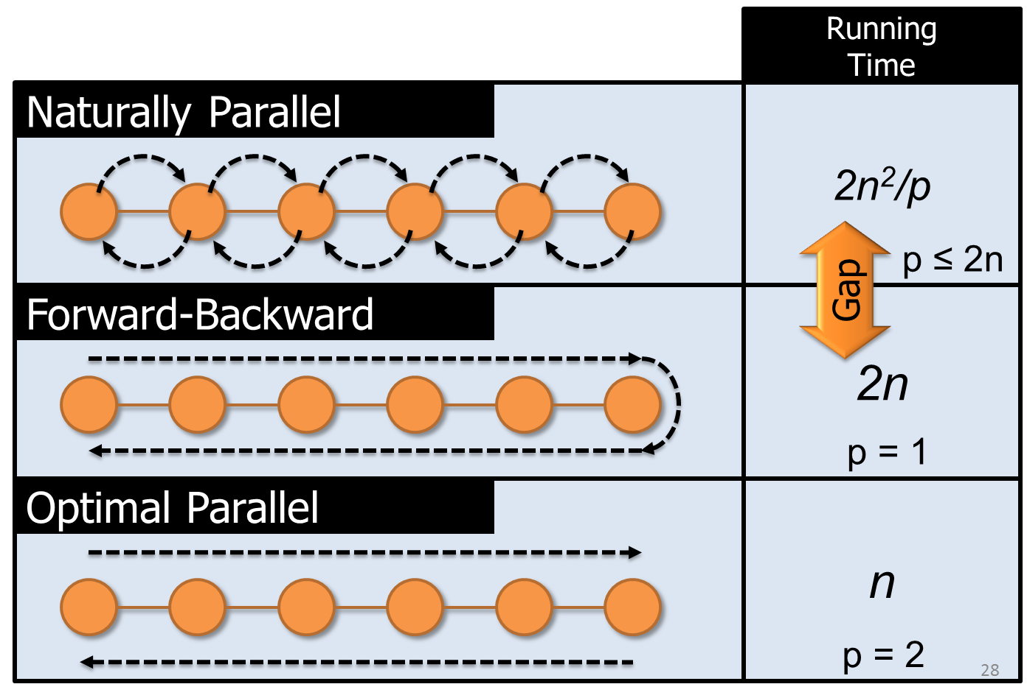
Synchronous Loopy BP
Natural parallelization: associate a processor to every node
Simultaneous receive, update, send
Inefficient – e.g., for a linear chain:
$2n/p$ time per iteration
$n$ iterations to converge
[SUML-Ch10]

Slide 6
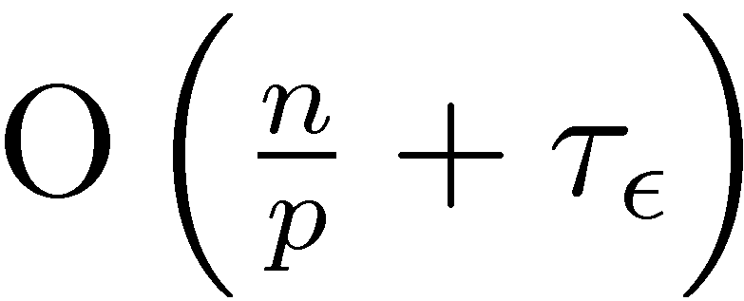
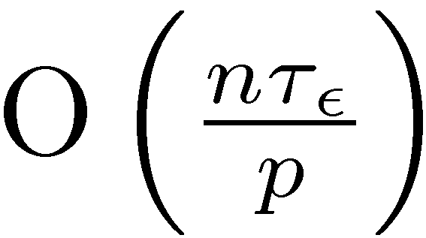
Optimal Parallel Scheduling
Partition, local forward-backward for center, then cross-boundary
Processor 1
Processor 2
Processor 3
Synchronous Schedule
Optimal Schedule
Gap
Parallel
Component
Sequential
Component
Notes:
We begin by evenly partitioning the chain over the processors <click> and selecting a center vertex or root for each partition. Then in parallel each processor sequentially computes messages inward to its center vertex forming forward pass. Then in parallel <click> each processor sequentially computes messages outwards forming the backwards pass. Finally each processor transmits <click> the newly computed boundary messages to the neighboring processors. In AIStats 09 we demonstrated that this algorithm is optimal for any given \epsilon. The running time of this new algorithm <click> isolates the parallel and sequential structure. Finally if we compare the running time of the optimal algorithm with that of the original naturally parallel algorithm <click> we see that the naturally parallel algorithm retains the multiplicative dependence on the hidden sequential component while the optimal algorithm has only an additive dependence on the sequential component.
Now I will show how to generalize this idea to arbitrary cyclic factor graphs in a way that retains optimality for chains.

Slide 7
Splash: Generalizing Optimal Chains
Select root, grow fixed-size BFS Spanning tree
Forward Pass computing all messages at each vertex
Backward Pass computing all messages at each vertex
Parallelization:
Partition graph
Maximize computation, minimize communication
Over-partition and randomly assign
Schedule multiple Splashes
Priority queue for selecting root
Belief residual: cumulative change from inbound messages
Dynamic tree pruning

Slide 8
DBRSplash: MLN Inference Experiments
Experiments: MLN Inference
8K variables, 406K factors
Single-CPU runtime: 1 hour
Cache efficiency critical
1K variables, 27K factors
Single-CPU runtime: 1.5 minutes
Network costs limit speedups

Slide 9
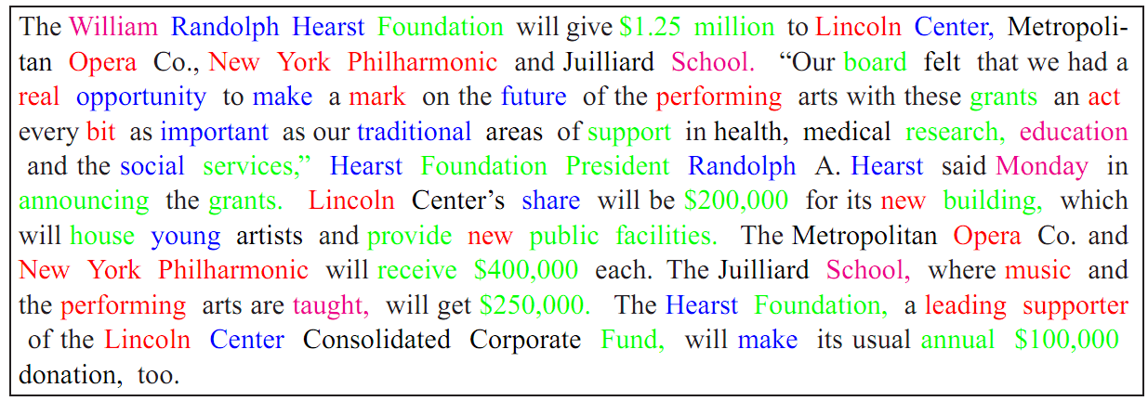
Topic Models
Goal: unsupervised detection of topics in corpora
Desired result: topic mixtures, per-word and per-document topic assignments
[B+03]

Slide 10
Directed Graphical Models: Latent Dirichlet Allocation [B+03, SUML-Ch11]
Generative model for document collections
$K$ topics, topic $k$: $Multinomial(φ_{k})$ over words
$D$ documents, document $j$:
Topic distribution $θ_{j}∼Dirichlet\left(α\right)$
$N_{j}$ words, word $x_{ij}$:
Sample topic $z_{ij}∼Multinomial\left(θ_{j}\right)$
Sample word $x_{ij}∼Multinomial\left(φ_{z_{ij}}\right)$
Goal: infer posterior distributions
Topic word mixtures $\{φ_{k}\}$
Document mixtures $\left\{θ_{j}\right\}$
Word-topic assignments $\{z_{ij}\}$
Prior on topic
distributions
$α$
Document’s
topic distribution
$θ_{j}$
Word’s topic
$z_{ij}$
Word
$x_{ij}$
$$N_{j}$$
$$D$$
Topic’s word distribution
$φ_{k}$
$$K$$
Prior on word distributions
$β$

Slide 11
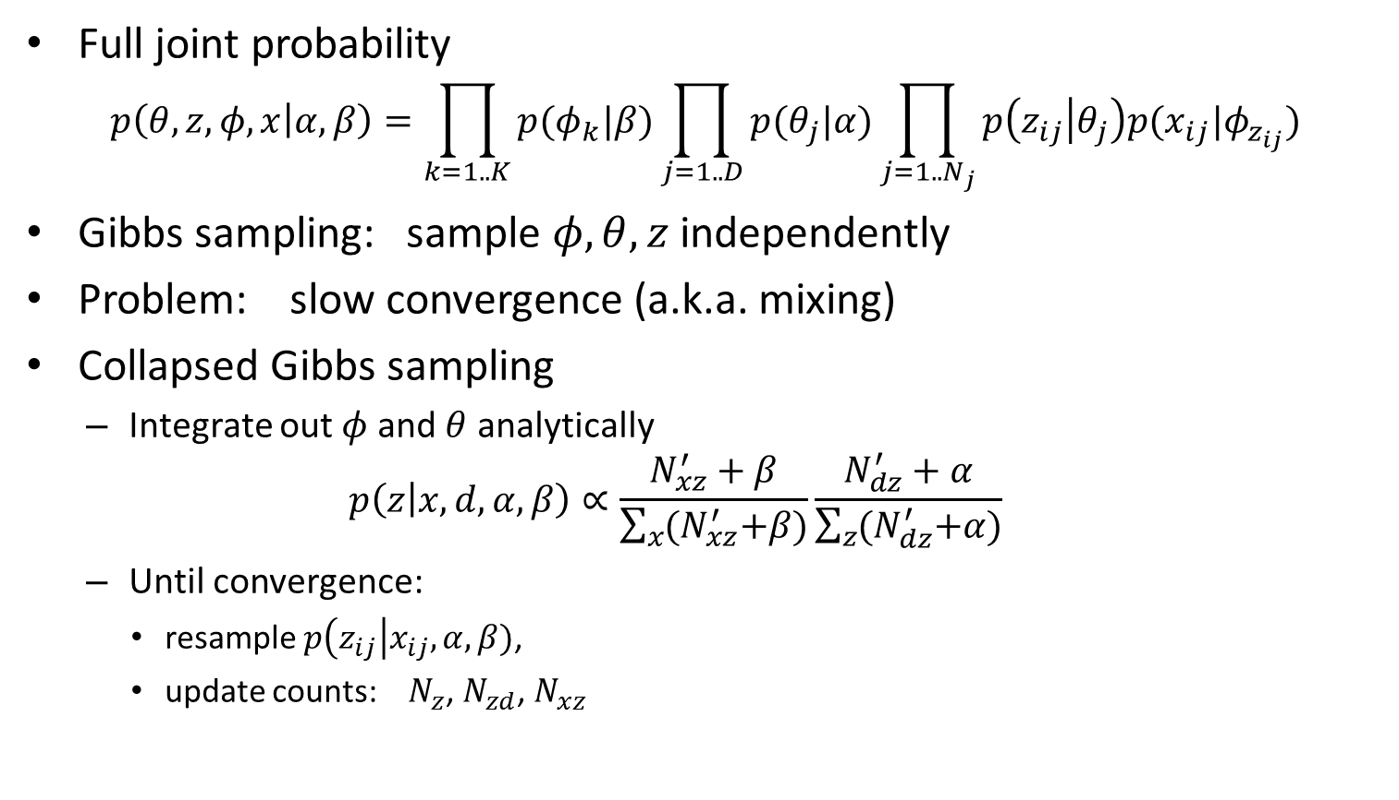
Gibbs Sampling
Full joint probability
$$p\left(θ, z, φ, x | α, β\right)=\prod_{k=1..K}{p(φ_{k}|β)}\prod_{j=1..D}{p(θ_{j}|α)}\prod_{j=1..N_{j}}{p\left(z_{ij} | θ_{j}\right)p(x_{ij}|φ_{z_{ij}})}$$
Gibbs sampling: sample $φ, θ, z$ independently
Problem: slow convergence (a.k.a. mixing)
Collapsed Gibbs sampling
Integrate out $φ$ and $θ$ analytically
$$p\left(z | x,d,α, β\right)∝\frac{N_{xz}^{′}+β}{\sum_{x}{{(N}_{xz}^{′}+β)}}\frac{N_{dz}^{′}+α}{\sum_{z}{{(N}_{dz}^{′}+α)}}$$
Until convergence:
resample $p\left(z_{ij}\right|x_{ij}, α, β)$,
update counts: $N_{z}$, $N_{zd}$, $N_{xz}$

Slide 12
Parallel Collapsed Gibbs Sampling [SUML-Ch11]
Synchronous version (MPI-based):
Distribute documents among $p$ machines
Global topic and word-topic counts $N_{z}, N_{wz}$
Local document-topic counts $N_{dz}$
After each local iteration, AllReduce $N_{z}, N_{wz}$
Asynchronous version: gossip (P2P)
Random pairs of processors exchange statistics upon pass completion
Approximate global posterior distribution (experimentally not a problem)
Additional estimation to properly account for previous counts from neighbor

Slide 13
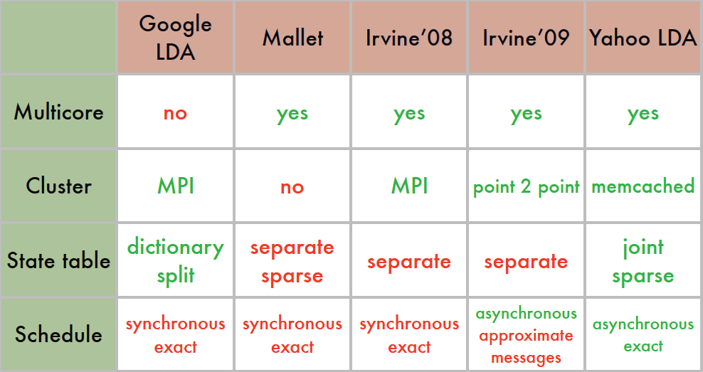
Parallel Collapsed Gibbs Sampling [SN10,S11]
Multithreading to maximize concurrency
Parallelize both local and global updates of $N_{xz}$ counts
Key trick: $N_{z}$ and $N_{xz}$ are effectively constant for a given document
No need to update continuously: update once per-document in a separate thread
Enables multithreading the samplers
Global updates are asynchronous -> no blocking
[S11]

Slide 14
Scaling Up Graphical Models: Conclusions
Extremely high parallelism is achievable, but variance is high
Strongly data dependent
Network and synchronization costs can be explicitly accounted for in algorithms
Approximations are essential to removing barriers
Multi-level parallelism allows maximizing utilization
Multiple caches allow super-linear speedups

Slide 15
References
[SUML-Ch11] Arthur Asuncion, Padhraic Smyth, Max Welling, David Newman, Ian Porteous, and Scott Triglia. Distributed Gibbs Sampling for Latent Variable Models. In “Scaling Up Machine Learning”, Cambridge U. Press, 2011.
[B+03] D. Blei, A. Ng, and M. Jordan. Latent Dirichlet allocation. Journal of Machine Learning Research, 3:993–1022, 2003.
[B11] D. Blei. Introduction to Probabilistic Topic Models. Communications of the ACM, 2011.
[SUML-Ch10] J. Gonzalez, Y. Low, C. Guestrin. Parallel Belief Propagation in Factor Graphs. In “Scaling Up Machine Learning”, Cambridge U. Press, 2011.
[KF10] D. Koller and N. Friedman Probabilistic graphical models. MIT Press, 2010.
[M01] K. Murphy. An introduction to graphical models, 2001.
[M04] K. Murphy. Approximate inference in graphical models. AAAI Tutorial, 2004.
[S11] A.J. Smola. Graphical models for the Internet. MLSS Tutorial, 2011.
[SN10] A.J. Smola, S. Narayanamurthy. An Architecture for Parallel Topic Models. VLDB 2010.
[W08] M. Wainwright. Graphical models and variational methods. ICML Tutorial, 2008.

